Slide 1


Chapter 11
(Campbell text)

Slide 2

Natural selection does not design: It tinkers.
Once a particular problem is solved, that solution is used over and over.
The harder the problem, the more universal the solution is.
Notes:
It does not envision a mouse trap and build the parts needed to suit the design, it sticks things together and keeps whatever works.
Why re-invent the wheel?
Compare universality of DNA maintenance to near universality of Protein synthesis to generalities in signaling.

Slide 3

Signaling evolved early in history of life
1. “sex” and yeast mating strains
2. signal-transduction pathways: process by which a signal on a cell’s surface is converted (probably originated in early prokaryotes)

Slide 4
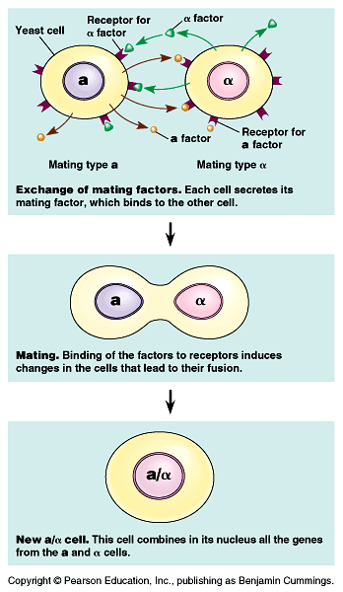

Slide 5
B. Communicating cells may be close together or far apart
1. paracine signaling—short distances (growth factors – non-specific)
2. synaptic signaling—short distances
(neurotransmitters – specific)
3. hormone signaling—long distances
4. direct contact—gap junctions (animals) and plasmodesmata (plants)

Slide 6
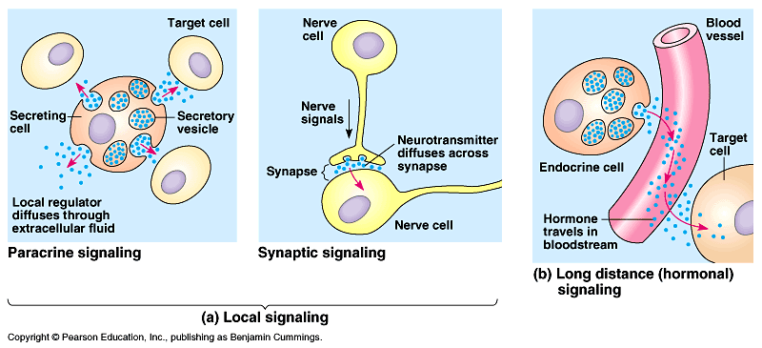

Slide 7
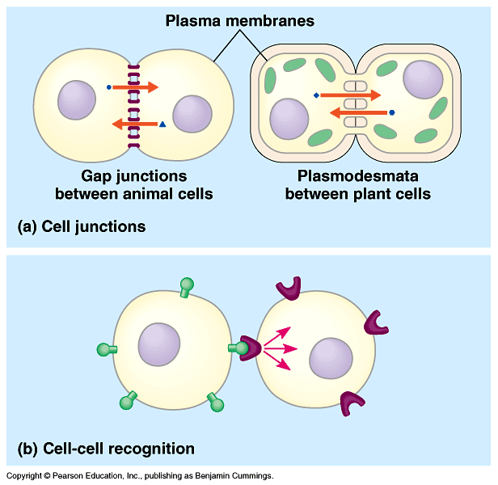

Slide 8

Epinephrine stimulates breakdown of glycogen to glucose 1-phosphate → glucose 6-phosphate.
Allows for energy to be released in an “emergency” in animals.
Epinephrine stimulates glycogen breakdown by activating a cytosolic enzyme, glycogen phosphorylase.
But – when they added epinephrine directly to glycogen phosphorylase and glycogen – no response (no breakdown). Why not?

Slide 9

Epinephrine couldn’t stimulate the catalysis of glycogen outside of a cellular environment.
Epinephrine does not interact directly with the enzyme responsible for glycogen breakdown (there are intermediate steps that occur).
The plasma membrane is needed to transmit the signal.

Slide 10
C. stages of cell signaling (Sutherland, 1971; role of epinephrine in the breakdown of glycogen)
1. reception—target cell’s detection of outside signal
2. transduction—conversion of signal to a form that can elicit a response
3. response – transduced signal triggers a specific response (ie. epinephrine released to promote conversion of glycogen to glucose)

Slide 11
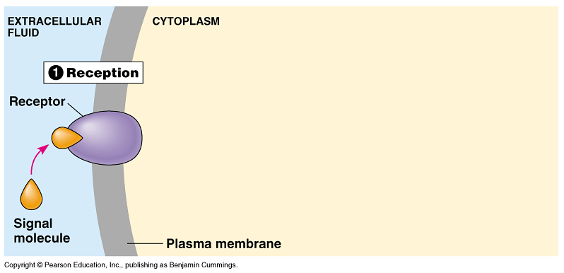

Slide 12
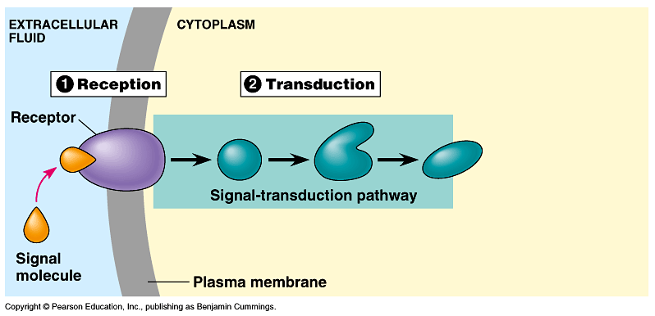

Slide 13
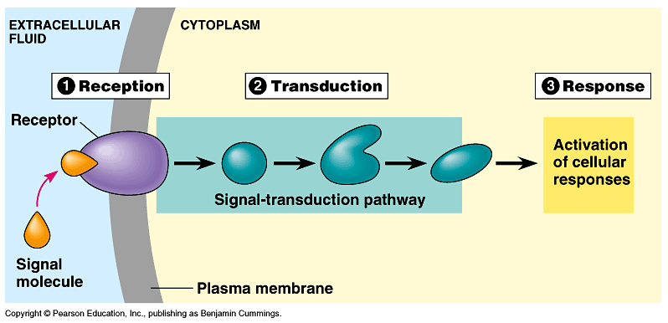

Slide 14

Signal binds to reception protein
1. “lock and key” specificity
2. ligand—a small molecule that specifically binds to another larger one
3. ligand binding results in change in shape of reception protein

Slide 15
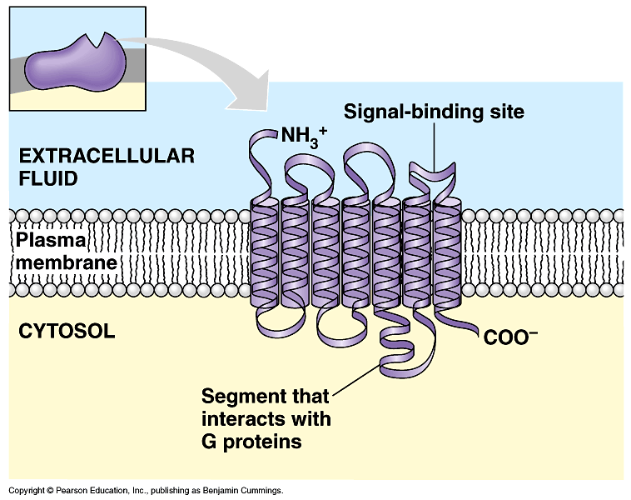

Slide 16
B. Types of signal receptors
1. G-protein linked receptors
a. G-proteins embedded in cell membranes
b. many molecules use G-protein receptors, including yeast mating factors, epinephrine, hormones, and neurotransmitters
c. involves use of GDP

Slide 17

Molecule binds to outside portion of receptor
Either binding of molecule or subsequent change in molecule changes shape of receptor
Shape change inside membrane changes association with a specific G-protein
The G-protein goes off and does its job, whatever that might be

Slide 18
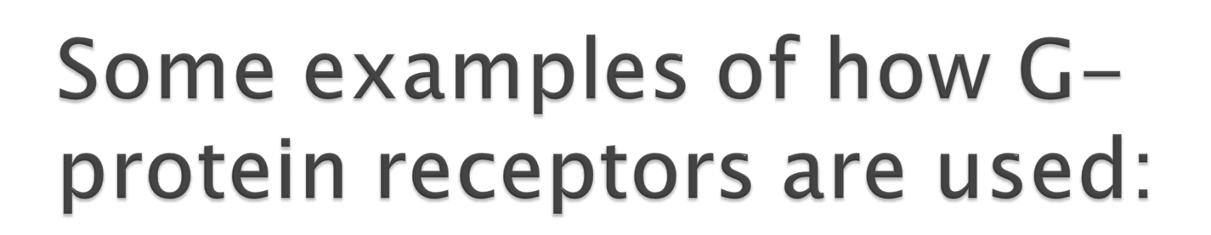
Transduce light (photosynthesis and phototaxis)
Receptors for sexual pheromones
Identify safe food
directional migration of cells
Identify invaders
Identify members of clan
Receptors for peptide hormones
Oh yeah...Detect everything you smell.
Notes:
Light detection

Slide 19
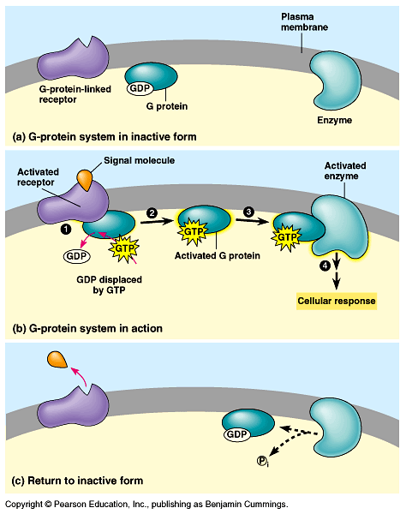

Slide 20

2. tyrosine-kinase receptors (omit)
3. ion-channel receptors
a. ligand-gated ion channels
b. example: synapses between neurons
4. Intracellular receptors
a. proteins located in cytoplasm or nucleus, not membrane
b. e.g. lipids, steroid hormones

Slide 21

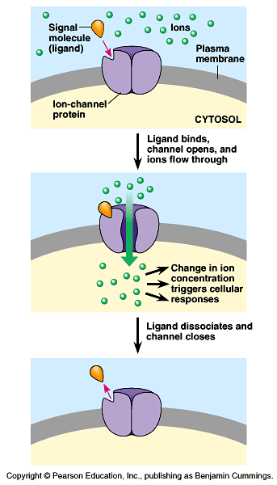

Slide 22

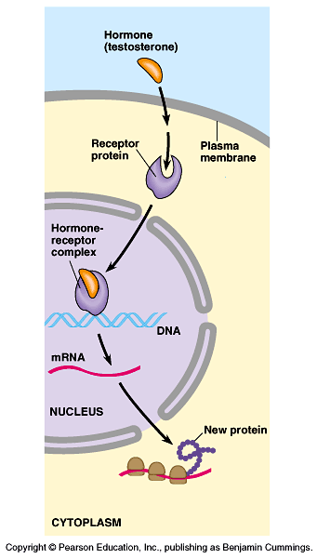

Slide 23

Pathways involve protein interaction
Protein phosphorylation
1. mechanism for regulating protein activity
2. involves protein kinase, an enzyme which transfers phosphate from ATP to protein
3. results in a cascade of reactions
(2% of human DNA codes for kinases)

Slide 24
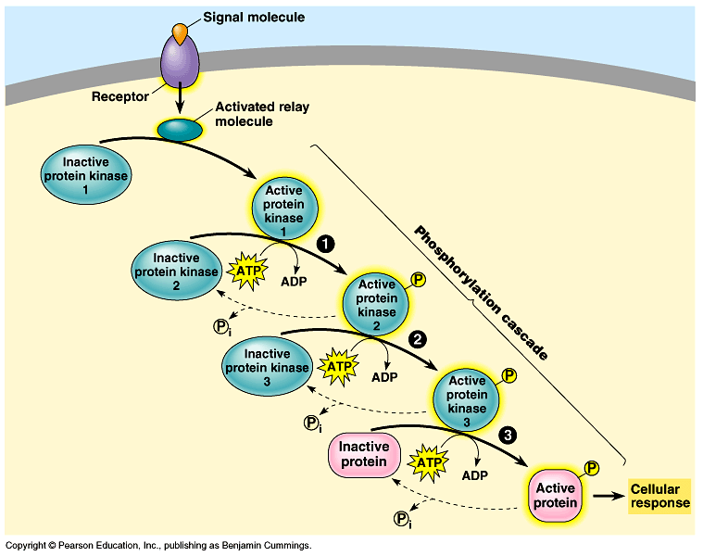

Slide 25
C. Second messengers (small, water-soluble, non-proteins; readily move through cytoplasm via diffusion)
ONE example is cyclic AMP
a. adenylyl cyclase embedded in membrane converts ATP to cAMP
b. cAMP is converted to inactive AMP
c. activation of protein kinase
d. phosphorylation of other proteins in cascade effect

Slide 26
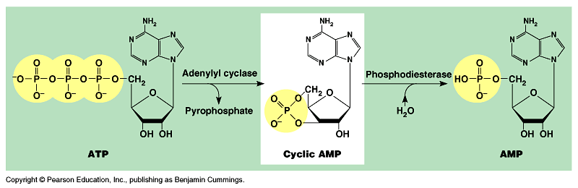

Slide 27
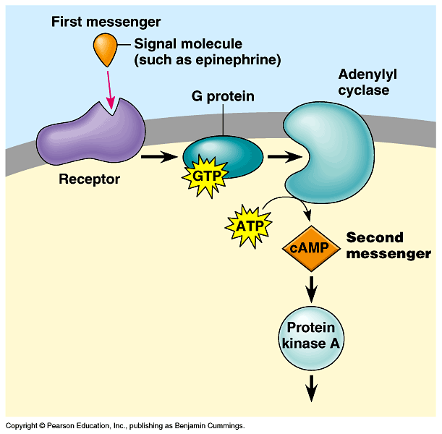

Slide 28

Cholera is epidemic in places where water supplies are contaminated with human feces. People drink the water, and Vibrio cholera colonize the small intestine, producing a toxin which modifies a G-protein involved in regulating water and salt secretion. G-protein can’t hydrolyze GTP to GDP and remains “stuck” in the active form, stimulating adenyl cyclase to make cAMP. Thus, intestinal cells secrete large amounts of water and salt into the intestines and cause life-threatening diarrhea.

Slide 29

Cytoplasmic responses (e.g. glycogen breakdown by epinephrine)
Nuclear response (e.g. activation of DNA by transcription factors to turn on/off genes)
Cell division

Slide 30
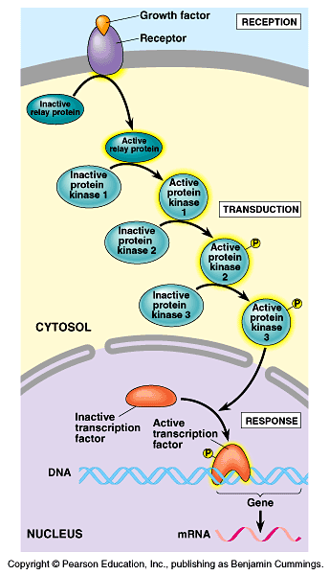

Slide 31
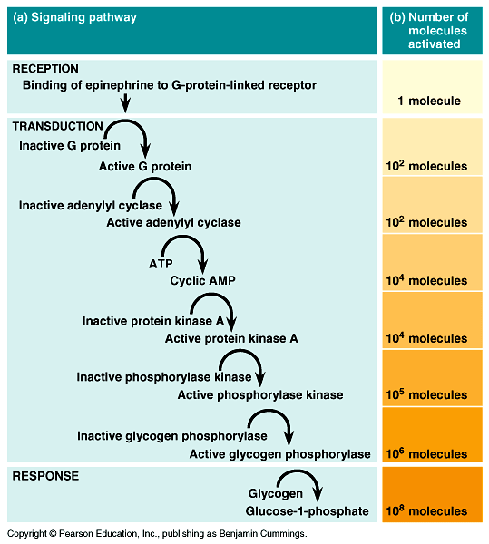

Slide 32

Why are there often so many steps between a signaling event at the cell surface and the cell’s response?
Answer:
  1. Many steps allow for the signal to be amplified
  2. Many steps allow for the specificity of response (example?)

Slide 33

Very early on before split with bacteria, cells evolved receptor for important chemicals and light
Receptors evolved astounding diversity in what they can bind and what they control
Often directly modulate cytoskeleton/motility
Can be coupled to almost cellular response
Evolution is cool, but not intelligent.

